Slide 1







Navigating IRB Processes for AI-Driven Clinical Research
Fahad Almsned, M.D., Ph.D., M.A.S.
Director, Advanced Analytics and Predictive Modelling at Eastern Health Cluster (E1) Director, Research Operations at KFSH-D
Institutional Review Board (IRB) Chairperson at KFSH-D Associate Consultant of Bioinformatics at KFSH-D Affiliated Graduate Faculty at George Mason University
R&D Consultant and Member of the Board of Advisors at GeneoClinic Health Track Lead, Artificial Intelligence Governance Association

Slide 2
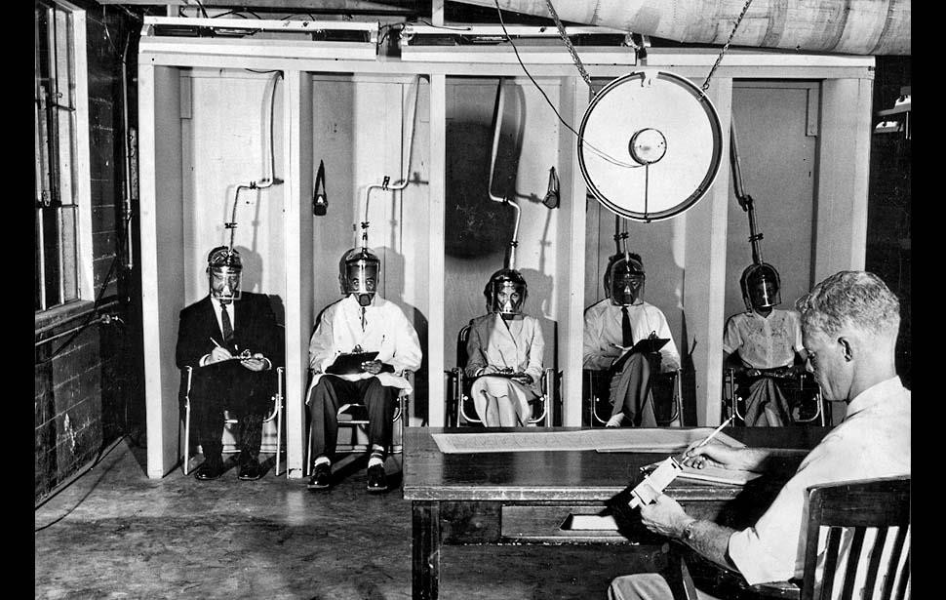
Objectives & Disclaimer
The Belmont Report and “The Common Rule.”
Introduction to Human Subjects Research (HSR).
Identifying When Artificial Intelligence (AI) Involves HSR.
Regulatory and Ethical Considerations for AI
Research.
Best Practices for Using Human Data in AI Studies.
Challenges for IRB in AI-Driven Clinical Research
Questions.
The views expressed in this presentation are those of the author and do not necessarily reflect the official policy or position of the E1.

Slide 3
Human Subjects Research Protections: A Brief Overview

Slide 4
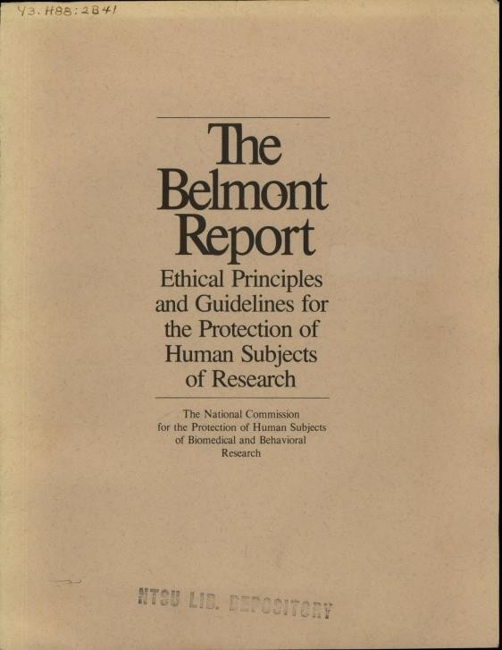

The Belmont Report (1979)
History: “Belmont” to the Code of Federal Regulations
The Tuskegee Study (1932 to 1972) by the U.S. Public Health Service, along with many other studies, identified significant ethical lapses.
The Belmont Report, a key ethics document, outlined principles for protecting human research subjects: Respect for Persons, Beneficence, and Justice. It guides the ethical design, conduct, and review of research.
Specific regulations were formally adopted, and explicit requirements are now found in The Codes of Federal Regulations, 32 CFR 219 and 45 CFR 46.
“The Common Rule” = 45 CFR 46, A
(IRB, IC, RC)

Slide 5


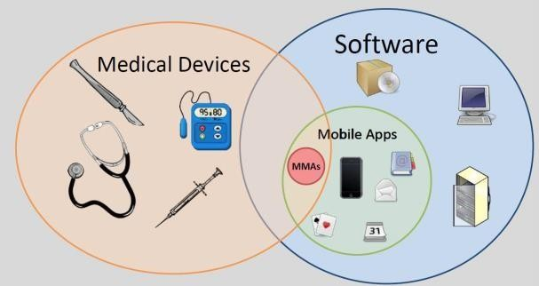



What is human subjects research (HSR)?
Federal Common Rule Definitions
Research: A systematic investigation, including research development, testing, and evaluation, designed to develop or contribute to generalizable knowledge.
Human Subject: A living individual about whom a researcher:
obtains information or biospecimens through intervention or interaction, and uses, studies, or analyzes it; (direct interaction or intervention); OR
obtains, uses, studies, analyzes, or generates identifiable private information or Biospecimens (already existing).

Slide 6
What is human subjects research (HSR)?
The Common Rule generally does not apply to deceased individuals. However, other regulations, such as HIPAA, state laws, and institutional policies, may regulate how their data and biospecimens are handled.
Protected Health Information (PHI) of deceased individuals remains protected under HIPAA for 50 years after the individual's death, which may require obtaining a waiver of authorization from an Institutional Review Board (IRB) and Proving the deceased status of individuals to access their medical information for research (not legally required).
Consent procedures might still apply if the research involves biospecimens from deceased individuals (e.g., organ or tissue donation). In many cases, this could involve prior consent from the deceased or their family before death.
Rules governing body donation for research, such as anatomical studies or biobanking, vary by jurisdiction and institution.

Slide 7
Artificial Intelligence: Overview and when might it be HSR?

Slide 8
What is Artificial Intelligence (AI)?
Artificial Intelligence (AI) is the simulation of human intelligence by machines, particularly computer systems.
It involves the development of algorithms and models that enable computers to perform tasks typically requiring human intelligence, such as learning, reasoning, problem-solving, perception, and natural language understanding.
Algorithm is an overarching term that describes any process or set of rules to be followed in calculations or other problem-solving operations.
An algorithm takes some input and uses mathematics and logic to produce the output. Technically, if → then is an algorithm.
AI algorithms take both inputs and outputs simultaneously to “learn” the data and produce outputs when given new inputs.
In Machine Learning, AI algorithms are “fed” data and asked to process it. AI algorithms are typically a collection of algorithms.
(AI and algorithm development require data…lots of data.)

Slide 9
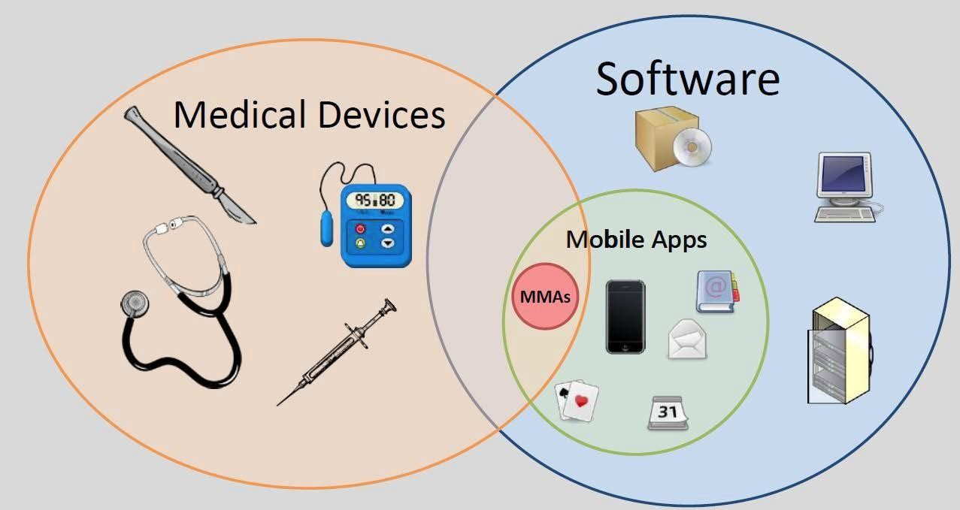
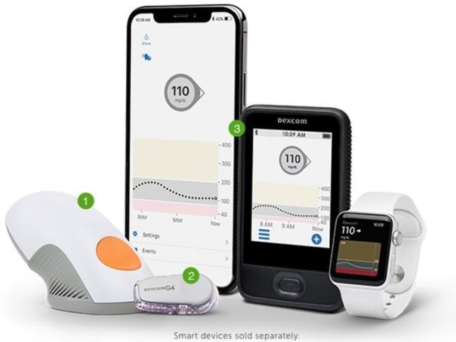
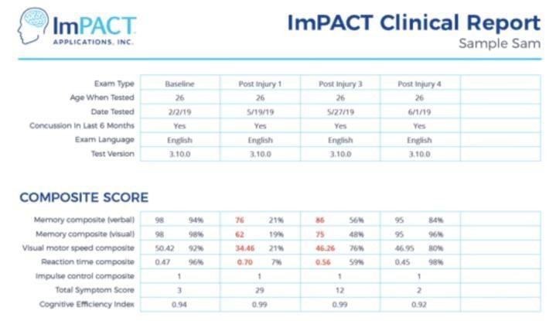
When might AI activity involve HSR? Medical example: Mobile Medical Apps
FDA-regulated research and development activity is a sub-set of HSR.
FDA Regulated: AI algorithms intended for use in the diagnosis of disease or other conditions, or in the cure, mitigation, treatment or prevention of.

Slide 10
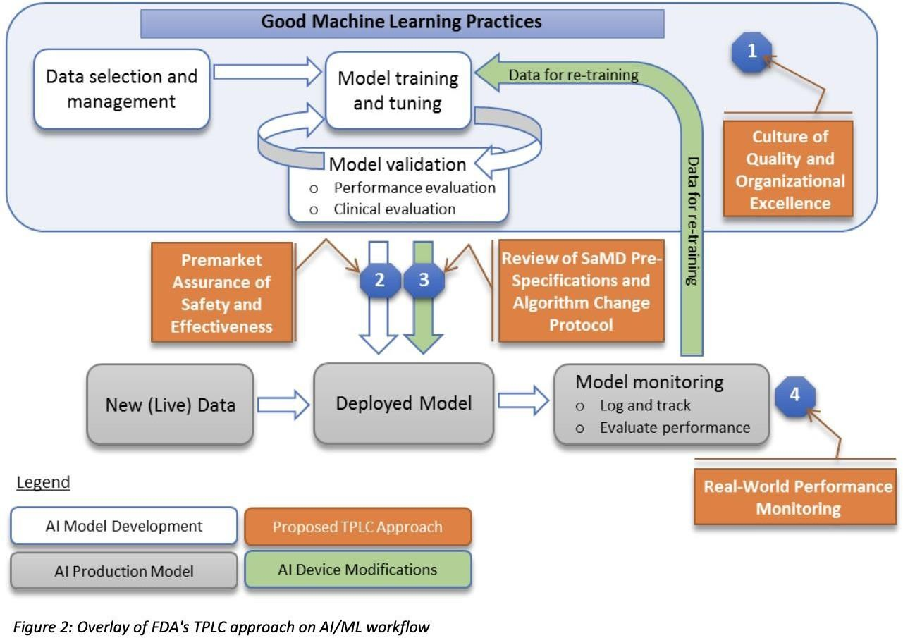
AI-based Software as a Medical Device (SaMD)
SaMD uses AI to perform medical functions, such as data analysis, diagnostics, and outcome prediction, without being part of a physical device.
Due to their significant impact on patient care, rigorous clinical validation, transparency, and ongoing monitoring are required to ensure reliable and equitable performance in healthcare settings.
FDA has issued AI-based SaMD Guidance, which HRPP reviewers apply to AI-HSR, which involves medical devices.

Slide 11
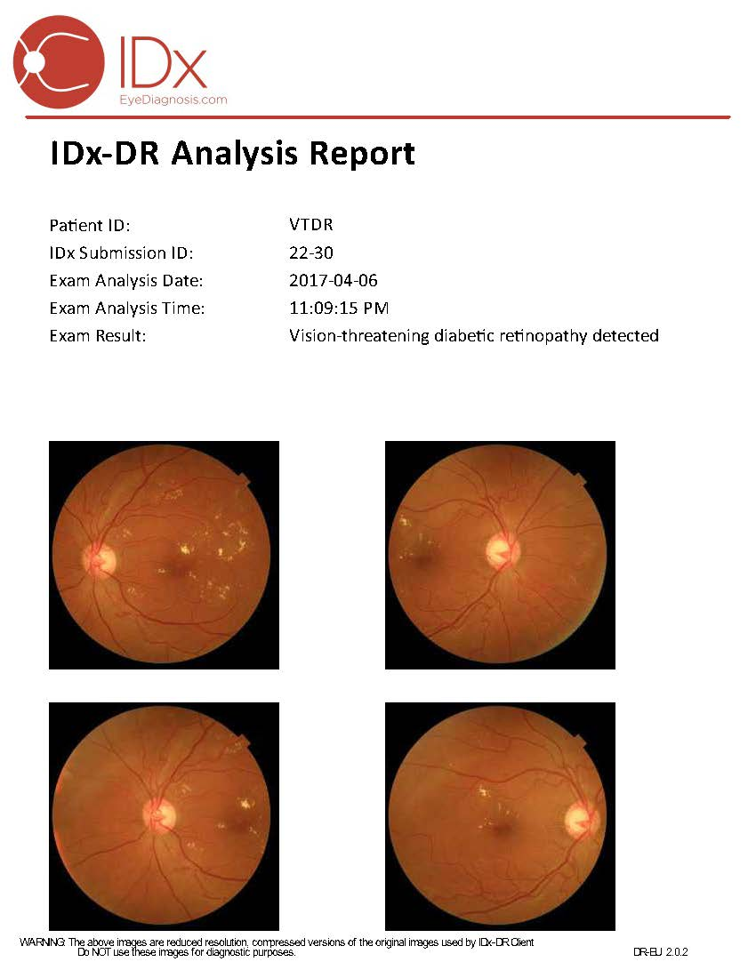
AI-based Software as a Medical Device (SaMD)
IDx-DR (FDA-approved AI diagnostic tool) detects diabetic retinopathy, a diabetes-related condition that can cause blindness.
The software analyzes retinal images taken by a standard camera and provides a diagnosis without requiring a specialist's interpretation.

Slide 12
When might AI activity involve HSR?
Non-Medical examples:
Use a human to interact with a robotic or machine to learn about human trust, response, and actions to develop/train the robotic or machine. (This is a Systematic investigation involving interaction/intervention with a living human.)
Access and use live human - identifiable facial images to develop and validate facial recognition technology. (Systematic investigation involving access and use of identifiable living human information.)

Slide 13
Regulatory and Ethical Considerations and IRB Challenges

Slide 14
Challenges for IRB in AI-Driven Clinical Research Data Privacy and Security
AI models require massive amounts of personal and health-related data to train and make accurate predictions. These datasets often include sensitive information such as genomic data, electronic health records (EHRs), and imaging data.
The collection, storage, and analysis of such extensive datasets increase the risk of unauthorized access and data breaches. The distributed nature of AI models (cloud-based platforms, multiple data sources) makes securing data a multifaceted challenge.
IRB Concerns:
Confidentiality: How will the researchers ensure that patient identities and private health information remain secure and anonymous?
Compliance with Regulations: Ensuring that AI applications in research align with regulations like HIPAA (Health Insurance Portability and Accountability Act) in the U.S. or GDPR (General Data Protection Regulation) in the EU. These regulations set strict standards for data protection, and any breach could lead to severe legal and ethical consequences.
Data Sharing and Ownership: Clarifying who has access to the data and how long it will be stored. This includes reviewing data-sharing agreements, which are mainly when AI applications involve international collaborations.

Slide 15
Challenges for IRB in AI-Driven Clinical Research Algorithm Transparency and Accountability
Many AI algorithms, especially deep learning and neural networks, operate in ways that are difficult to interpret (Black Box), making it hard for researchers and the IRB to understand fully how conclusions or predictions are reached. This lack of interpretability becomes critical when AI models make patient-related decisions (e.g., determining eligibility for clinical trials or predicting treatment outcomes).
The complexity of AI models poses challenges in assessing their safety, reliability, and fairness. If the internal logic of the AI system is not fully understood, risk assessment becomes difficult for IRBs (Accountability).
IRB Concerns:
Transparency of AI Models: How will the researchers explain the AI’s decision-making process in an understandable and assessable way by the IRB? This is essential for determining the ethical implications of AI-driven decisions.
Auditing and Validation: What mechanisms are in place to audit AI outputs and ensure that they are safe, reliable, and consistent? IRBs will need to verify that the AI has been tested adequately before being deployed in clinical research.
Safety Assessments: Understanding how errors or biases in the AI model can be identified and corrected is critical to protecting patient safety and ensuring the research’s integrity.

Slide 16
Challenges for IRB in AI-Driven Clinical Research Informed Consent in AI-Driven Research
AI’s role in clinical research, especially when making predictions or influencing decisions (such as treatment allocation), adds complexity to the informed consent process. Participants may find it difficult to fully understand how AI influences them, which raises ethical concerns about whether participants are truly informed when consenting to participate in AI-driven research.
AI models can evolve as they learn from new data during a study. This creates challenges in ensuring that participants understand the dynamic nature of the AI system and how their data might be used over time.
IRB Concerns:
Clarity of Information: Ensuring participants are provided with clear, understandable information about AI’s role in the study. This includes explaining how AI and the possible risks or limitations of the technology will use their data.
Ongoing Consent: If the AI model evolves over time, is there a need for re-consent? IRBs must consider whether participants should be notified if the AI system's function or use changes during the study.
Risk-Benefit Communication: The complexity of AI could make it difficult for participants to grasp the full extent of potential risks and benefits. IRBs need to evaluate whether the consent process adequately conveys these factors and ensures that participants understand the implications of AI-driven research.

Slide 17
Regulatory and ethical considerations when AI intersects with HSR
Seek guidance/assistance from your servicing HRPP or IRB (early).
If in doubt whether AI activity is HSR, seek an official determination by servicing HRPP staff.
Navigating regulatory provisions while using the large amounts of human data needed for AI development can be complex. Remember the notable concepts about “identifiable” and “private” information.
A hallmark requirement is informed consent to access and use private, personal identifying data (or a waiver by an HRPP reviewer if appropriate).

Slide 18
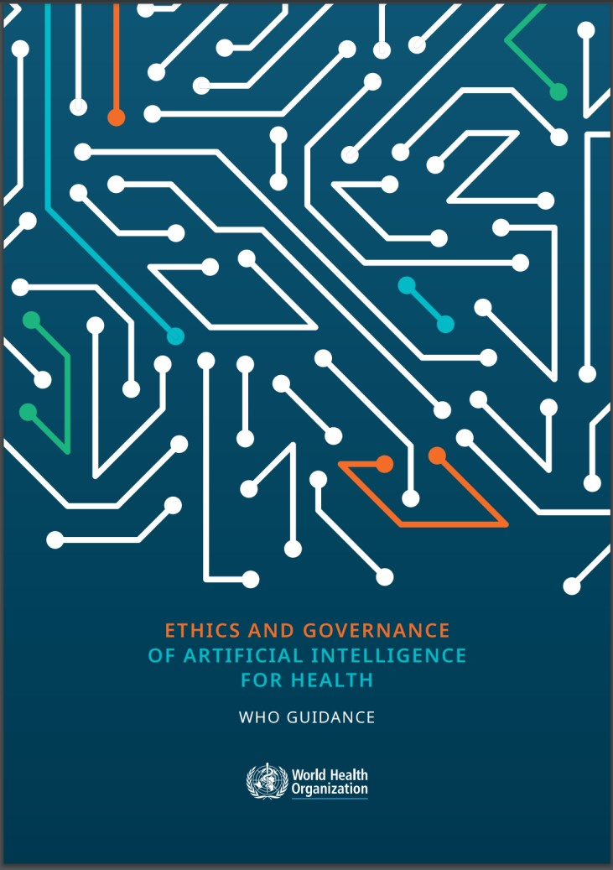
AI Ethical Requirements
The WHO report on "Ethics and Governance of Artificial Intelligence for Health" offers essential guidance on ethical AI use in healthcare.
Recommendations for policymakers, researchers, and practitioners to integrate AI into health systems while maintaining public trust and protecting vulnerable populations.
The WHO report outlines five key ethical principles for the use of AI in healthcare: Responsible; Equitable; Traceable; Reliable; and Governable

Slide 19



Together for a healthier world
Thank you!
falmsned@moh.gov.sa
https://twitter.com/Fahad_Almsned
https://www.linkedin.com/in/fahad-almsned
Notes:
Thank you so much for your time!
Here are my email address and my Twitter and LinkedIn accounts. Please do not hesitate to contact me If you have any questions.
Thanks again!

